Slide 1
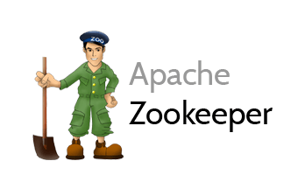
Versions
Current Version: 3.4.9
Version Used: 3.4.6

Slide 2
Agenda
History of Zookeeper
Distributed Application
Challenges in Distributed Application
What is Zookeeper
Zookeeper Services
Zookeeper Architecture
Zookeeper Data Model and Hierarchical Namespace
Znodes
Zookeeper Shell
References
Assignment
2

Slide 3





























Big Data Ecosystem
Streaming Engines
Data Store
Data Processing
Peripherals
Data Services
Distributions
Cloud Exposure
3
3

Slide 4
History of Zookeeper
The Zookeeper framework was originally built at “Yahoo!” for accessing their applications in an easy and robust manner.
Later, Apache ZooKeeper became a standard for organized service used by Hadoop, HBase, and other distributed frameworks.
For example, Apache HBase uses ZooKeeper to track the status of distributed data.
4

Slide 5
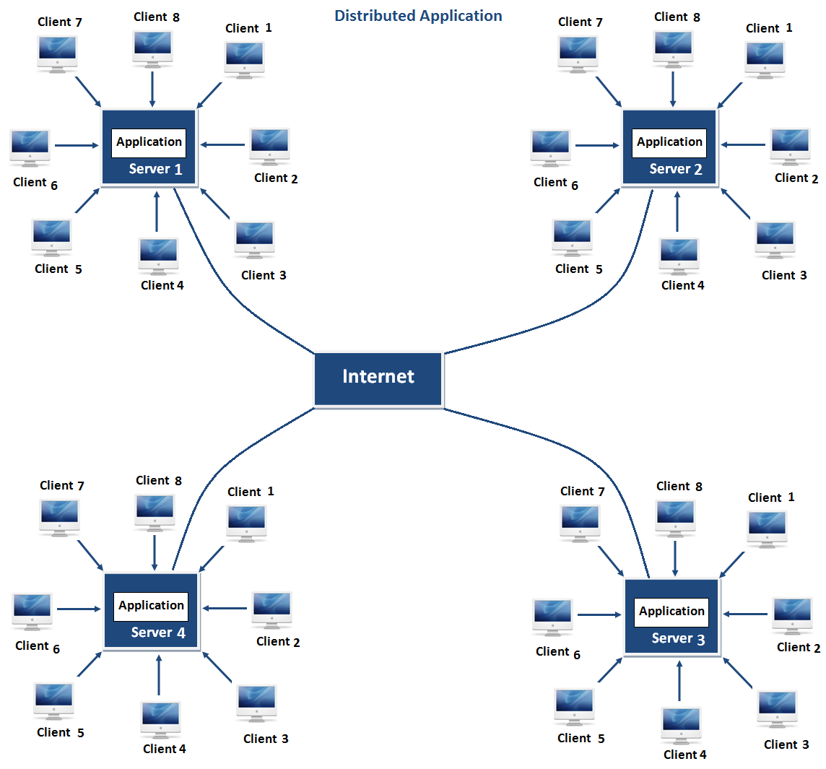
Distributed Application
A distributed application can run on multiple systems in a network at a given time (simultaneously) by coordinating among themselves to complete a particular task in a fast and efficient manner.
Coordination in a Distributed System:
Locking
Leader Election
Synchronization
5

Slide 6
Challenges in Distributed Application
Race condition −
Two or more machines trying to perform a particular task, which actually needs to be done only by a single machine at any given time. For example, shared resources should only be modified by a single machine at any given time.
Deadlock −
Two or more operations waiting for each other to complete indefinitely.
Inconsistency −
Partial failure of data.
6

Slide 7
What is Zookeeper
ZooKeeper is a distributed, open-source coordination service for distributed applications.
It exposes a simple set of primitives that distributed applications can build upon to implement higher level services for synchronization, configuration maintenance, and groups and naming.
ZooKeeper solves this issue with its simple architecture.
ZooKeeper allows developers to focus on core application logic without worrying about the distributed nature of the application.
It runs in Java and has bindings for both Java and C.
7

Slide 8
Zookeeper services
Naming service − Identifying the nodes in a cluster by name.
Configuration management − Latest and up-to-date configuration information of the system for a joining node.
Cluster management − Joining / leaving of a node in a cluster and node status at real time.
Leader election − Electing a node as leader for coordination purpose.
Locking and synchronization service − Locking the data while modifying it. This mechanism helps you in automatic fail recovery while connecting other distributed applications like Apache HBase.
Highly reliable data registry − Availability of data even when one or a few nodes are down.
8

Slide 9
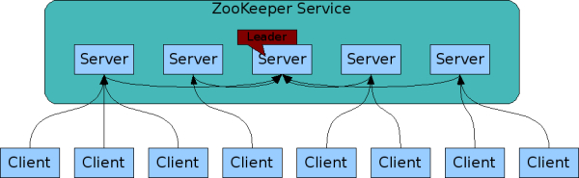
Zookeeper Architecture
Notes:
9

Slide 10
Zookeeper Architecture
Client − Clients, one of the nodes in our distributed application cluster, access information from the server. For a particular time interval, every client sends a message to the server to let the sever know that the client is alive.
Server − Server, one of the nodes in our ZooKeeper ensemble, provides all the services to clients. Gives acknowledgement to client to inform that the server is alive.
Leader − Server node which performs automatic recovery if any of the connected node failed. Leaders are elected on service startup.
Follower − Server node which follows leader instruction.
10

Slide 11
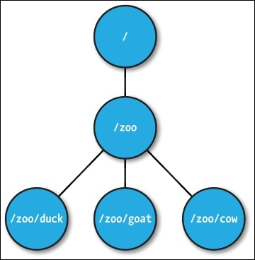
Zookeeper Data Model and Hierarchical Namespace
The name space provided by ZooKeeper is much like that of a standard file system.
A name is a sequence of path elements separated by a slash (/).
Every node in ZooKeeper's name space is identified by a path.
Each node in namespace is called znode
Znodes maintain a stat structure that includes version numbers for data changes, ACL changes, and timestamps, to allow cache validations and coordinated updates.
11

Slide 12
Zookeeper Znodes
Znodes are categorized as persistence, ephemeral.
Persistence znode − Persistence znode is alive even after the client, which created that particular znode, is disconnected. By default, all znodes are persistent unless otherwise specified.
Ephemeral znode − Ephemeral znodes are active until the client is alive. When a client gets disconnected from the ZooKeeper ensemble, then the ephemeral znodes get deleted automatically. Ephemeral znodes play an important role in Leader election.
12

Slide 13
Zookeeper Shell
To perform ZooKeeper CLI operations, first turn on your ZooKeeper server (“bin/zkServer.sh start”) and then, ZooKeeper client (“bin/zkCli.sh”). Once the client starts, you can perform the following operation.
Create znodes
Get data
Watch znode for changes
Create children of a znode
List children of a znode
Check Status
Remove / Delete a znode
13

Slide 14
Reference
Zookeeper site : https://zookeeper.apache.org/
Downloading Zookeeper : https://zookeeper.apache.org/releases.html
Documentation:
Zookeeper : https://zookeeper.apache.org/doc/trunk/

Slide 15
Questions?

Slide 16
Assignment
Install Zookeeper

